Slide 1
Microsoft Excel - Tools
Prassanjeet Singh Dhanjal

Slide 2
Topics covered
Tables
Pivot Tables
Macro (non VBA)
ODBC
OLEDB

Slide 3
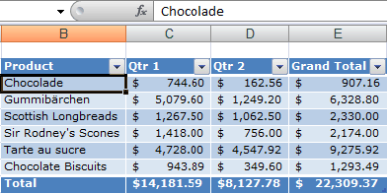
Tables 1
To make managing and analyzing a group of related data easier, you can turn a range of cells into a Microsoft Office Excel table (previously known as an Excel list). A table typically contains related data in a series of worksheet rows and columns that have been formatted as a table. By using the table features, you can then manage the data in the table rows and columns independently from the data in other rows and columns on the worksheet.

Slide 4
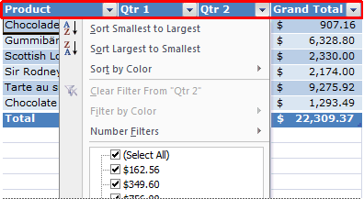
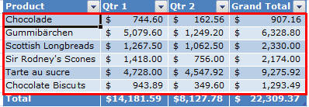
Tables Elements of an Excel table 2
Header row By default, a table has a header row. Every table column has filtering enabled in the header row so that you can filter or sort your table data quickly.
Banded rows By default, alternate shading or banding has been applied to the rows in a table to better distinguish the data.

Slide 5
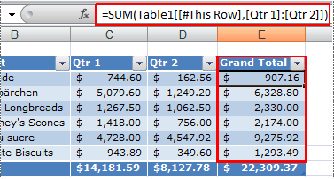
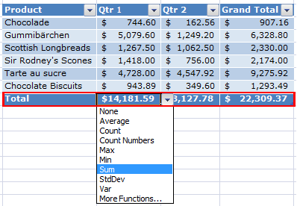
Tables Elements of an Excel table 3
Calculated columns By entering a formula in one cell in a table column, you can create a calculated column in which that formula is instantly applied to all other cells in that table column.
Total row You can add a total row to your table that provides access to summary functions (such as the AVERAGE, COUNT, or SUM function). A drop-down list appears in each total row cell so that you can quickly calculate the totals that you want.

Slide 6
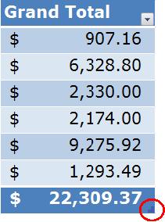
Tables Elements of an Excel table 4
Sizing handle A sizing handle in the lower-right corner of the table allows you to drag the table to the size that you want.

Slide 7
Tables-Managing data in an Excel table 5
Sorting and filtering Filter drop-down lists are automatically added in the header row of a table. You can sort tables in ascending or descending order or by colour, or you can create a custom sort order. You can filter tables to show only the data that meets the criteria that you specify, or you can filter by colour. For more information on how to filter or sort data, see Filter data or Sort data.
Formatting table data You can quickly format table data by applying a predefined or custom table style. You can also choose Table Styles options to display a table with or without a header or a totals row, to apply row or column banding to make a table easier to read, or to distinguish between the first or last columns and other columns in the table. For more information on how to format table data, see Format an Excel table.
Inserting and deleting table rows and columns You can use one of several ways to add rows and columns to a table. You can quickly add a blank row at the end of the table, include adjacent worksheet rows or worksheet columns in the table, or insert table rows and table columns anywhere that you want. You can delete rows and columns as needed. You can also quickly remove rows that contain duplicate data from a table. For more information about adding and deleting table rows and columns, see Add or remove Excel table rows and columns.
Using a calculated column To use a single formula that adjusts for each row in a table, you can create a calculated column. A calculated column automatically expands to include additional rows so that the formula is immediately extended to those rows. For more information on how to create a calculated column, see Create, edit, or remove a calculated column in an Excel table.
Displaying and calculating table data totals You can quickly total the data in a table by displaying a totals row at the end of the table and then using the functions that are provided in drop-down lists for each totals row cell. For more information on how to display and calculate table data totals, see Total the data in an Excel table.
Using structured references Instead of using cell references, such as A1 and R1C1, you can use structured references that reference table names in a formula.
Ensuring data integrity For tables that are not linked to SharePoint lists, you can use the built-in data validation features in Excel. For example, you may choose to allow only numbers or dates in a column of a table. For more information on how to ensure data integrity, see Prevent invalid data entry on a worksheet.
Exporting to a SharePoint list You can export a table to a SharePoint list so that other people can view, edit, and update the table data.

Slide 8
Pivot Tables 1
Create a PivotTable report
By using a PivotTable report, you can summarize, analyze, explore, and present a summary of your worksheet data or an external data source. A PivotTable report is especially useful when you have a long list of figures to sum, and aggregated data or subtotals would help you look at the data from different perspectives and compare figures of similar data.
For example, the following PivotTable report shows how the total third-quarter Golf department sales in cell F3 compare to sales for another sport, or quarter, or to the total sales of all departments.

Slide 9
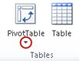
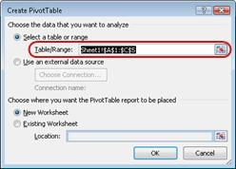
Pivot Tables-Steps 2
Define the data source for the PivotTable report To use worksheet data as the data source, click a cell in the range of cells that contains the data. To use data in a Microsoft Excel table as the data source, click a cell inside the Excel table. Note Make sure that the range has column headings or that headers are displayed in the table, and that there are no blank rows in the range or table.
Create the PivotTable report
On the Insert tab, in the Tables group, click PivotTable.
Tip To create a PivotChart that is based on the PivotTable report at the same time, click the arrow below PivotTable, and then click PivotChart.
In the Create PivotTable dialog box, make sure that Select a table or range is selected, and then in the Table/Range box, verify the range of cells.

Slide 10
Pivot Tables-Steps 3
Excel automatically determines the range for the PivotTable report, but you can replace it by typing a different range or a name that you defined for the range. For data in another worksheet or workbook, include the workbook and worksheet name by using the following syntax [workbookname]sheetname!range.
Tip You can also click Collapse Dialog to temporarily hide the dialog box, select the range on the worksheet, and then click Expand Dialog .
Do one of the following:
To place the PivotTable report in a new worksheet starting at cell A1, click New Worksheet.
To place the PivotTable report at a specific location in an existing worksheet, select Existing Worksheet, and then in the Location box, specify the first cell in the range of cells where you want to position the PivotTable report.
Click OK.
Excel adds an empty PivotTable report to the specified location and displays the PivotTable Field List so that you can add fields, create a layout, and customize the PivotTable report.
Note If you created a PivotChart at the same time, it is displayed on top of the associated PivotTable report. A PivotChart and its associated PivotTable report must always be in the same workbook.

Slide 11
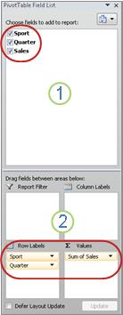
Pivot Tables-Steps 4
Add fields to the PivotTable report In the PivotTable Field List, do one or more of the following: To place a field in the default area of the layout section, select the check box next to the field name in the field section.
By default, nonnumeric fields are added to the Row Labels area, numeric fields are added to the Values area, and Online Analytical Processing (OLAP) date and time hierarchies are added to the Column Labels area.
1. The field section contains the field names of the fields you can add to the Layout section
2. The layout section contains the Report Filter area, the Column Labels area, the Row Labels area, and the Values area.
To place a field in a specific area of the layout section, right-click the field name in the field section, and then select Add to Report Filter, Add to Column Label, Add to Row Label, or Add to Values.
To drag a field to the area that you want, click and hold the field name in the field section, and then drag it to an area in the layout section.
Tip You can use the PivotTable Field List to rearrange the fields later as needed by right-clicking the fields in the layout section, and then selecting the area that you want, or by dragging the fields between the areas in the layout section.

Slide 12
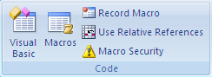
Macro (non VBA) 1
Overview
To automate a repetitive task, you can quickly record a macro in Microsoft Excel. You can also create a macro by using the Visual Basic Editor in Microsoft Visual Basic for Applications (VBA) to write your own macro script, or to copy all or part of a macro to a new macro. After you create a macro, you can assign it to an object (such as a toolbar button, graphic, or control) so that you can run it by clicking the object. If you no longer use a macro, you can delete it.
Record a macro
When you record a macro, the macro recorder records all the steps required to complete the actions that you want your macro to perform. Navigation on the Ribbon is not included in the recorded steps.
If the Developer tab is not available, do the following to display it:
Click the File tab.
Click Options, and then click Customize Ribbon.
In the Customize Ribbon category, in the Main Tabs list, select the Developer check box, and then click OK.
To set the security level temporarily to enable all macros, do the following:
On the Developer tab, in the Code group, click Macro Security.
Under Macro Settings, click Enable all macros (not recommended, potentially dangerous code can run), and then click OK.

Slide 13
Macro (non VBA) 2
Note To help prevent potentially dangerous code from running, we recommend that you return to any one of the settings that disable all macros after you finish working with macros.
For more information about how to change the settings, see Change macro security settings in Excel.
3. On the Developer tab, in the Code group, click Record Macro.
4. In the Macro name box, enter a name for the macro.
Note The first character of the macro name must be a letter. Subsequent characters can be letters, numbers, or underscore characters. Spaces cannot be used in a macro name; an underscore character works well as a word separator. If you use a macro name that is also a cell reference, you may get an error message that the macro name is not valid.
5. To assign a CTRL combination shortcut key to run the macro, in the Shortcut key box, type any lowercase letter or uppercase letter that you want to use.
Note The shortcut key will override any equivalent default Excel shortcut key while the workbook that contains the macro is open.
For a list of CTRL combination shortcut keys that are already assigned in Excel, see Excel shortcut and function keys.
6. In the Store macro in list, select the workbook where you want to store the macro.

Slide 14
Macro (non VBA) 3
Tip If you want a macro to be available whenever you use Excel, select Personal Macro Workbook. When you select Personal Macro Workbook, Excel creates a hidden personal macro workbook (Personal.xlsb) if it does not already exist, and saves the macro in this workbook. In Windows Vista, this workbook is saved in the C:\Users\user name\AppData\Local\Microsoft\Excel\XLStart folder. In Microsoft Windows XP, this workbook is saved in the C:\Documents and Settings\user name\Application Data\Microsoft\Excel\XLStart folder. Workbooks in the XLStart folder are opened automatically whenever Excel starts. If you want a macro in the personal macro workbook to be run automatically in another workbook, you must also save that workbook in the XLStart folder so that both workbooks are opened when Excel starts.
7. In the Description box, type a description of the macro.
8. Click OK to start recording.
9. Perform the actions that you want to record.
10. On the Developer tab, in the Code group, click Stop Recording .
Tip You can also click Stop Recording on the left side of the status bar.

Slide 15
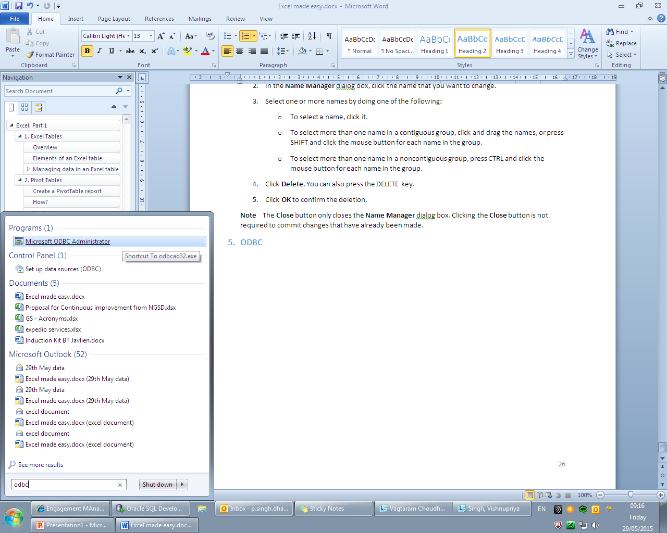
ODBC 1
What is ODBC?
Open Database Connectivity (ODBC) is a technology that programs use to access a wide range of databases (or data sources). For example, ODBC can be used to import data from a MySQL database into a Microsoft Excel spreadsheet. To do this, your computer needs the correct ODBC driver and data source.
Search for ODBC from the start menu

Slide 16
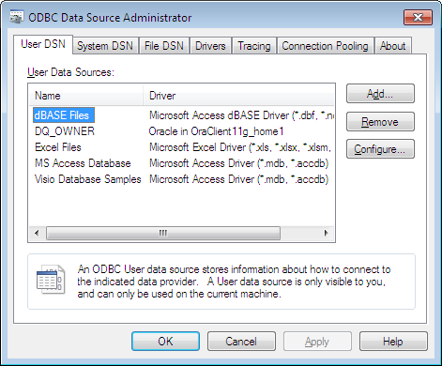
ODBC 2
Open Microsoft ODBC Administrator
Click on “Add” to register new User data source

Slide 17
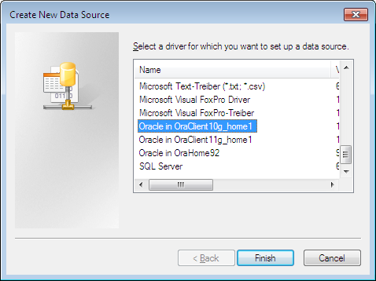
ODBC 3
Select the driver that you want to use for registering your connection to database
Note: Try to select the latest version for your database but if any error due to driver installation occurs, do switch to a lower version

Slide 18
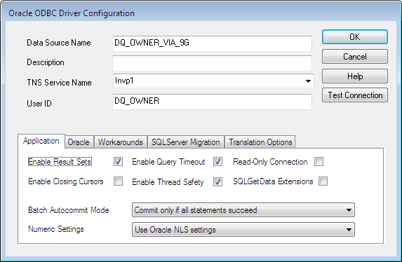
ODBC 4
The configuration dialog box will look as shown:

Slide 19
ODBC 5
Oracle ODBC Driver Configuration Dialog Box
NOTE: The Oracle ODBC Driver Configuration dialog box is available for Microsoft Windows users only.
The above graphic is an example of the Oracle ODBC Driver Configuration dialog box.
The Oracle ODBC Driver Configuration dialog box.
The following list is an explanation of the main setup options and fields found on the Oracle ODBC Driver Configuration dialog box shown in the preceding graphic. The tabs found on the lower half of this dialog box are described in subsequent help topics.
Data Source Name - the name used to identify the data source to ODBC. For example, "odbc-pc". You must enter a Data Source Name.
Description - a description or comment about the data in the data source. For example, "Hire date, salary history, and current review of all employees." The Description field is optional.
TNS Service Name - the location of the Oracle database from which the ODBC driver will retrieve data. This is the same name entered in configuring network database services using the Oracle Net Configuration Assistant (NETCA). For more information, see the NETCA documentation and Using the Oracle ODBC Driver for the First Time. The TNS Service Name can be selected from a pulldown list of available TNS names. For example, "ODBC-PC". You must enter a TNS Service Name.
User ID - the user name of the account on the server used to access the data. For example, "scott“ or “DQ_OWNER”. The User ID field is optional.
You must enter the Data Source Name and the TNS Service Name. You can provide the other information requested in the dialog box or you can leave the fields blank and provide the information when you run the application.
In addition to the main setup options previously described, there is a Test Connection button available. The Test Connection button verifies whether the ODBC environment is configured properly by connecting to the database specified by the Data Source Name definition.

Slide 20
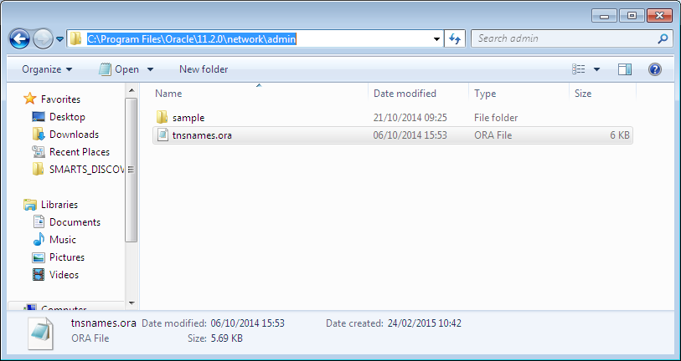
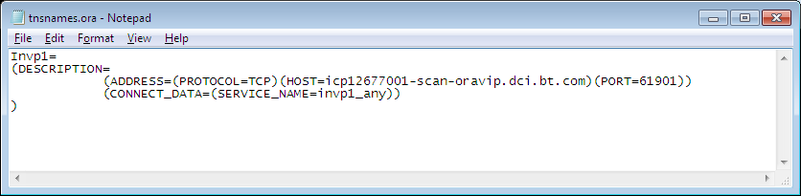
ODBC 6
TNS should be stored in the network\admin folder of the base Oracle directory
The TNS details should be in the format as shown in the image

Slide 21
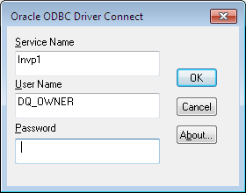
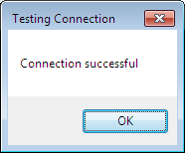
ODBC 7
When you press the Test Connection button, you are prompted for the username and password.

Slide 22
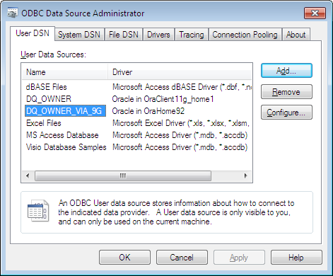
ODBC 8
Press “OK” to save your configuration settings
You can observe, now your Data source name is reflected in the ODBC Data Source Administrator

Slide 23
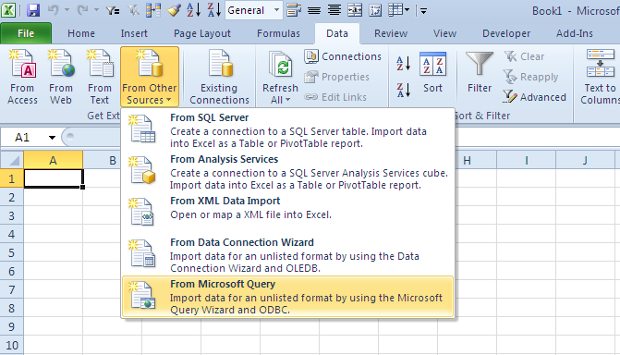
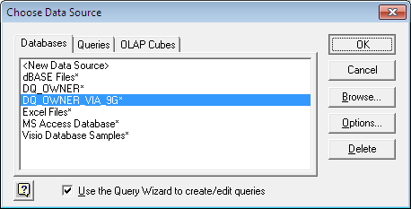
ODBC 9
Open/switch to MS Excel
On the ribbon, select Data menu
Now click on “From Other Source” and select “From Microsoft Query” in the drop down
Select the connection source you have saved and press “OK”

Slide 24
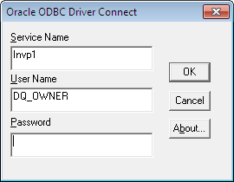
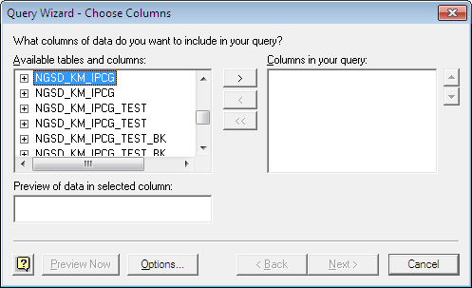
ODBC 10
It will ask for the credentials
Enter the Password and press “OK”
It will open the query wizard dialog box
Select the table name which you want to select from the DB

Slide 25
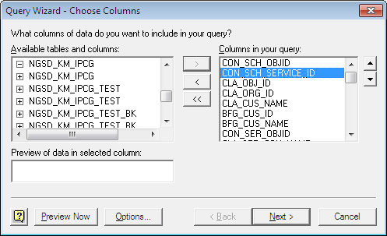
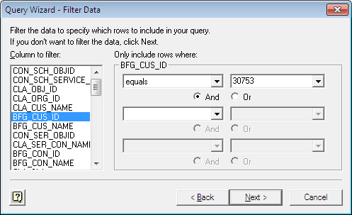
ODBC 11
You can select specific columns of the table if you want
Press “Next”
Now you can select the columns where you want to apply filters
If you do not wish to apply filter, keep the fields blank
Press “Next”

Slide 26
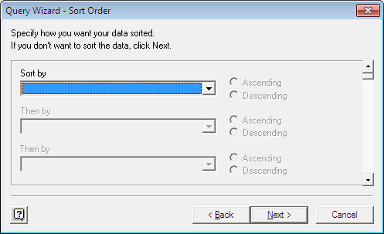
ODBC 12
You will get the option to sort the data on the selected columns in the table in ascending or descending order
Press “Next”

Slide 27
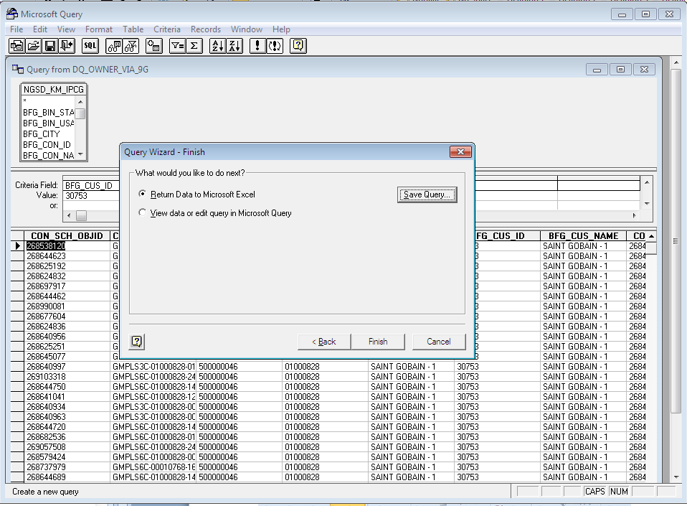
ODBC 13
You will be asked by the wizard to “Return the data to MS Excel” i.e. do want it to fetch the data now in the excel sheet or to “View data or edit query in MS Query” i.e. look at the preview of the query and edit if want

Slide 28
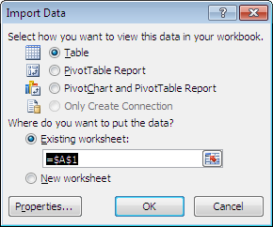
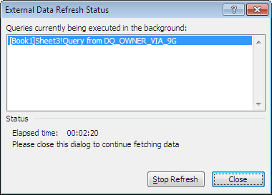
ODBC 14
If you select the option to Return the data in the Excel, you will be given option to select the location for placing your data
You can also select if you want your data to be presented in the form of a)Table b)Pivot Table Report c)PivotChart & PivotTable Report
If you want the data to be fetched directly, select “Table” and press “OK”
You will observe the as soon as you press “OK”, at the bottom left side of the screen there will be a status and option to cancel the extract operation
And if you press that option to cancel, you will see the “External Data Refresh Status” Dialog Box

Slide 29
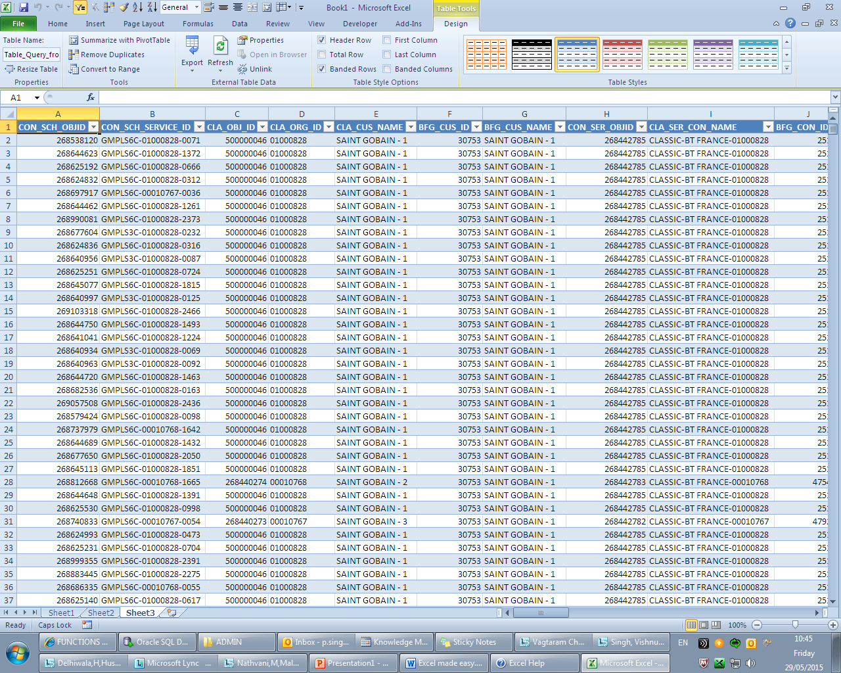
ODBC 15
After the extraction is complete, you will see the data the following format as shown
It is already inserted into a table with default table name which can be changed from the ribbon -> Table Tools menu -> Design ->Table Name

Slide 30
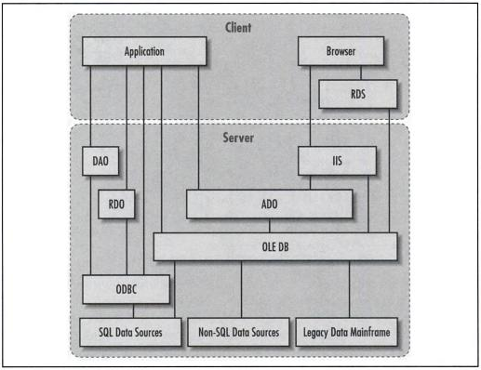
OLE DB
1
OLE DB (Object Linking and Embedding, Database, sometimes written as OLEDB or OLE-DB) separates the data store from the application that needs access to it through a set of abstractions that include the datasource, session, command, and rowsets. This was done because different applications need access to different types and sources of data, and do not necessarily want to know how to access functionality with technology-specific methods. OLE DB is conceptually divided into consumers and providers. The consumers are the applications that need access to the data, and the providers are the software components that implement the interface and thereby provides the data to the consumer. OLE DB is part of the Microsoft Data Access Components (MDAC) stack.
Referred from :
ADO ActiveX Data Objects
By Jason T. Roff

Slide 31
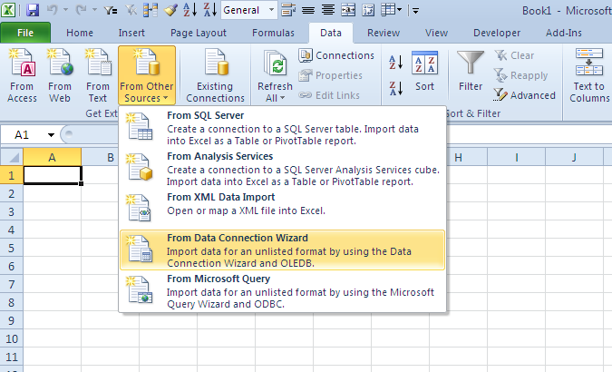
OLEDB
2
Open/switch to MS Excel
On the ribbon, select Data menu
Now click on “From Other Source” and select “From Data Connection Wizard” in the drop down

Slide 32
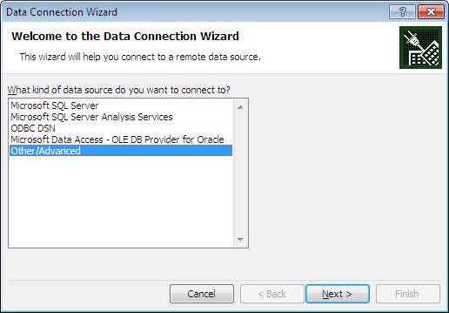
OLEDB
3
In the Data Connection Wizard dialog box, select “Other/Advanced” option and press “Next”

Slide 33
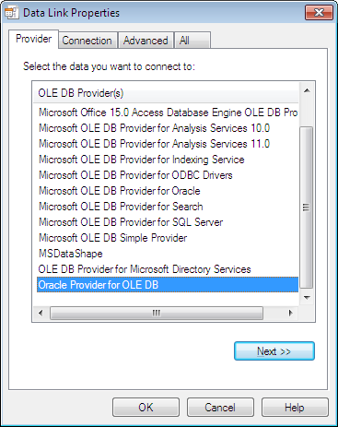
OLEDB
4
Then you will be asked to select the provider(driver) which you want to use for creating the connection
Select the “Oracle Provider for OLE DB”
Press “Next”

Slide 34
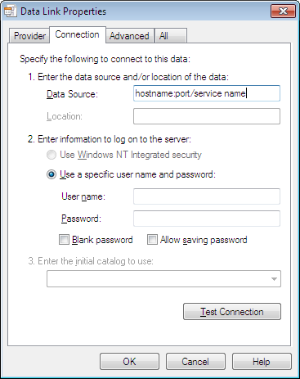
OLEDB
5
When you have selected OLE DB Provider, it will prompt you to enter your Data Source
You should enter the data source in the format: <hostname>:<port>/<service_name>
Also enter the user name(schema Name) and password in their respective input box
Now press the “Test Connection” button to check if the connection can be established
Blank password provide option if there is no password for the user name
Allow saving password will expose your password in the excel sheet but save you from entering the credentials every time you refresh your table

Slide 35
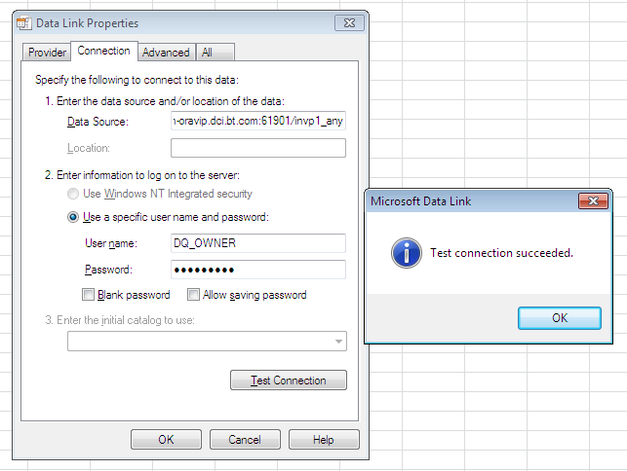
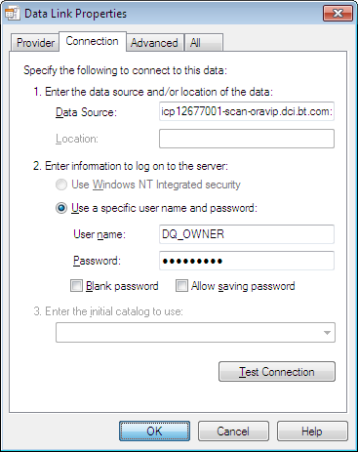
OLEDB
6
If you get the message as shown, you can press the “OK” button to establish the connection and get the object list from the database

Slide 36
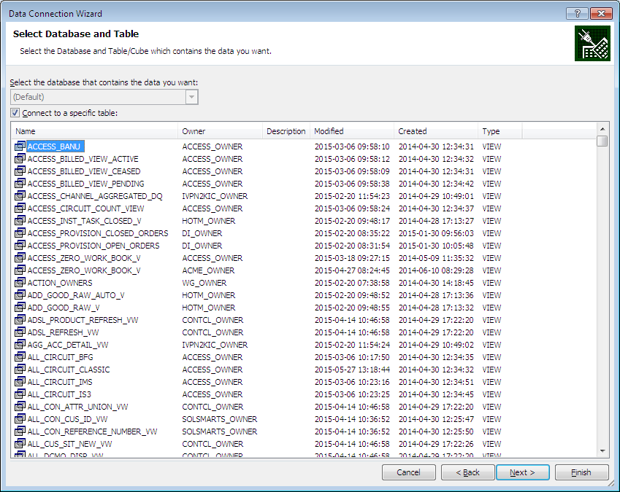
OLEDB
7
You will get an option to select a particular table/view from the database
NOTE: If you opt to deselect “Connect to a specific table”, you can save the connection details in an .odc (office database connection) file. Once you have done that, it will ask you to select the table
HINT: Select a table with low count of rows and columns

Slide 37
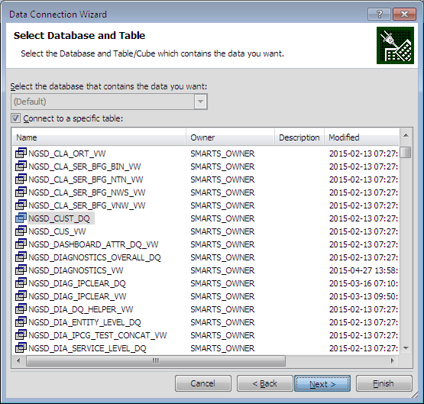
OLEDB
8
As an example, let us select NGSD_CUST_DQ that gives the DQ for customer attributes.
Press “Next”

Slide 38
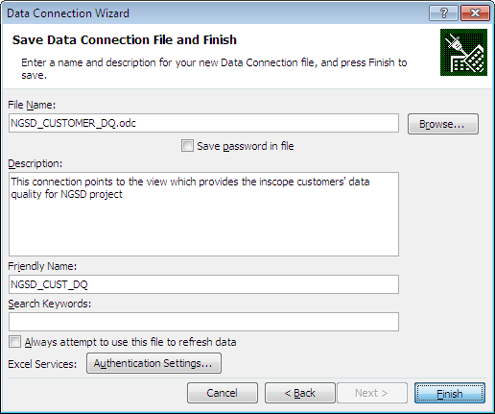
OLEDB
9
Once you have selected your table, it will ask you to name the .odc file and a friendly name which office will save for future reference
Note: Please name the file and friendly name carefully to avoid confusion in case you have planned to create many reports/odc files
Friendly name is the name by which your table can be called once data is fetched in the excel sheet
Press “Finish”

Slide 39

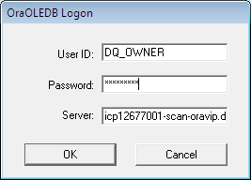
OLEDB
10
You will be given option to select the location for placing your data
You can also select if you want your data to be presented in the form of a)Table b)Pivot Table Report c)PivotChart & PivotTable Report
If you have not saved the password, it will give an error: Null password given.
Please provide password in that case
Note: <hostname>:<port>/<service name>

Slide 40
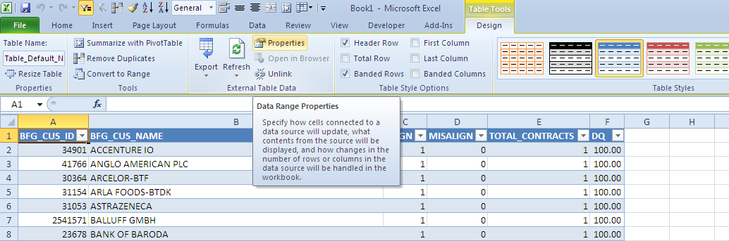
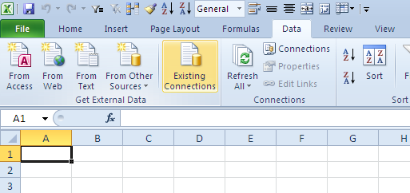
OLEDB
11
And so data is fetched
How to use existing connection to save time in creating connection
Go to “Data” menu in the ribbon
Select “Existing Connections” option

Slide 41
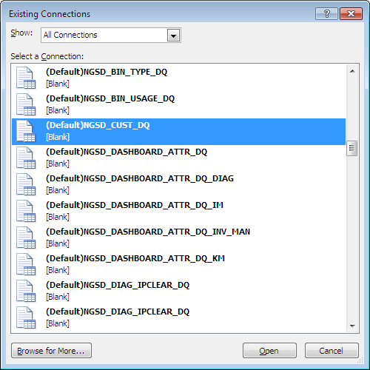
OLEDB
12
Select a connection which may give fewer records i.e. which will take very less time to fetch data

Slide 42
OLEDB
13
Null password given: Please provide password
<hostname>:<port>/<service name>
Once data is fetched, go to -> Design -> Properties

Slide 43
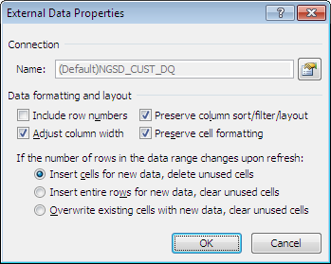
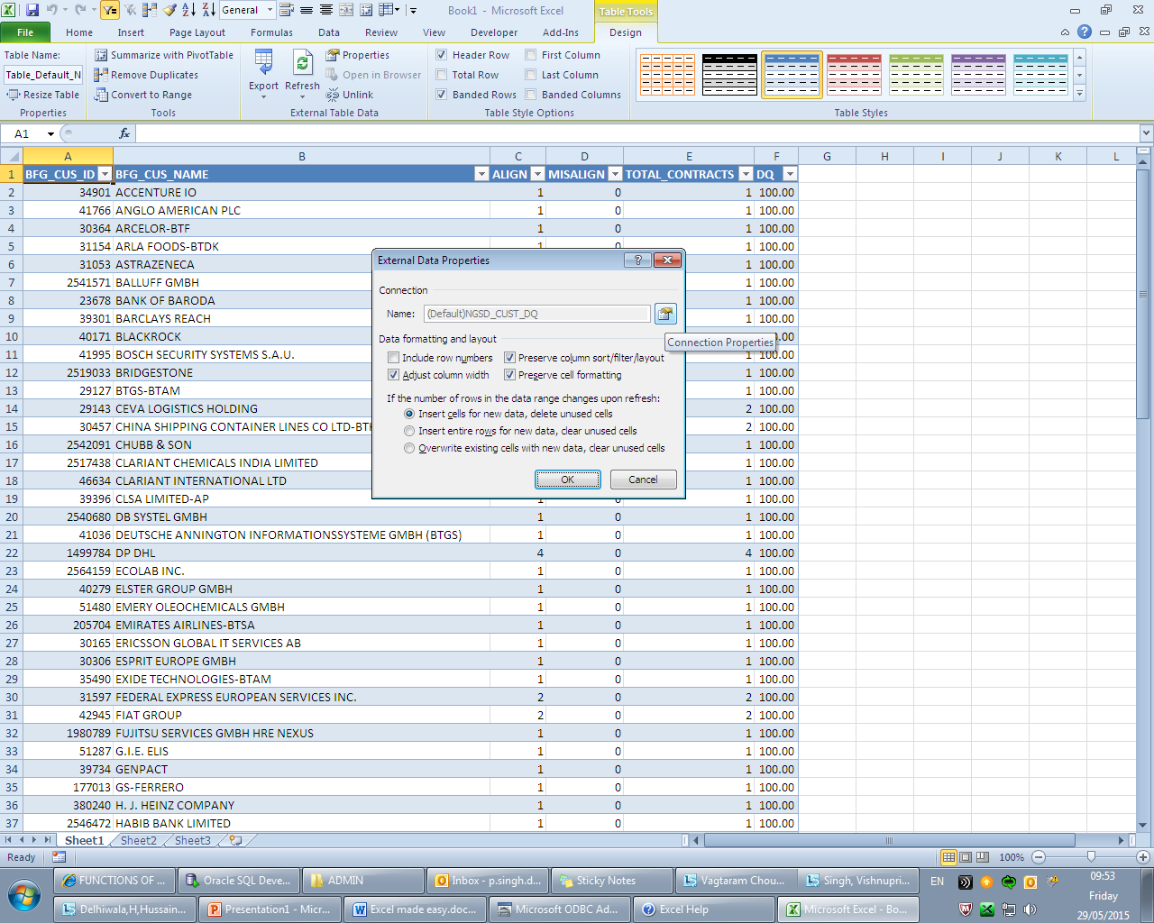
OLEDB
14
Connection properties
Use the Connection Properties dialog box to control various settings for connections to external data sources, and to use, reuse, or switch connection files.
Select Connection Properties

Slide 44
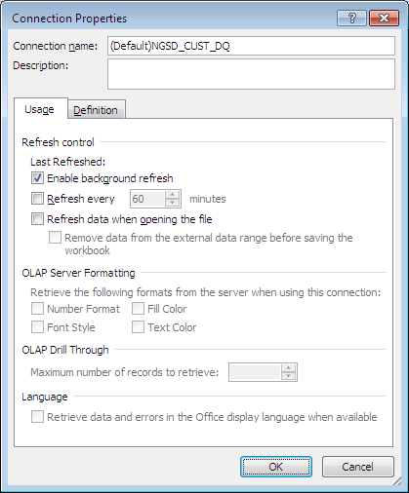
OLEDB
15
You will get the following dialog box
Go to the “Definition” tab of the setting

Slide 45
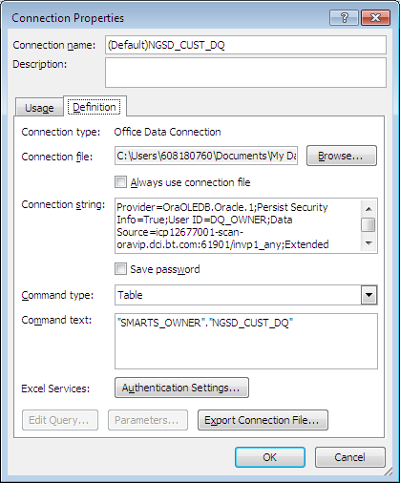
OLEDB
16
Select one of the following command types:
SQL
Table
Default
Command text will allow you to select a table/view or write the query which you want to execute
Rename the Connection name after changing the Command text
You can also export the connection file to odc file format in case you want to reuse it
Press “OK”
Hereby you have reused the connection details for other SQL statement or table

Slide 46
OLEDB
17
Connection Properties fields:
Connection name and Description boxes These display the connection name and an optional description. To change the name and description, click the text in the box, and then edit the text. The connection name and description are displayed as columns in the Workbook Connections dialog box. (On the Data tab, in the Connections group, click Connections.)
Usage tab options
The settings on the Usage tab control the way that the connection information is used in the workbook.
Refresh control
Enable background refresh Select this check box to run the query in the background. Clear this check box to run the query while you wait. Running a query in the background enables you to use Excel while the query runs.
Refresh every n minutes Select this check box to enable automatic external data refresh at regular time intervals, and then enter the number of minutes between each refresh operation. Clear this check box to disable automatic external data refresh.
Refresh data when opening the file Select this check box to automatically refresh external data when you open the workbook. Clear this check box to immediately open the workbook without refreshing external data.
Remove data from the external data range before saving the workbook Select this check box if you want to save the workbook with the query definition but without the external data. Clear this check box to save the query definition and data with the workbook. This check box becomes available only after you select the Refresh data when opening the file check box.

Slide 47
OLEDB
18
Connection Properties fields (continued):
Usage tab options
OLAP Server Formatting
Controls whether the following OLAP server formats are retrieved from the server and are displayed with the data.
Number Format Select or clear this check box to enable or disable number formatting, such as currency, date, or time.
Font Style Select or clear this check box to enable or disable font styles, such as bold, italic, underline, or strike-through.
Fill Color Select or clear this check box to enable or disable fill colors.
Text Color Select or clear this check box to enable or disable text colors.
OLAP Drill Through
Maximum number of records to retrieve Enter a number from 1 to 10,000 to specify the maximum number of records to retrieve when you expand a level of data in a hierarchy.
Language
Retrieve data and errors in the Office display language when available Select or clear this check box to enable or disable the retrieval of translated data and errors, if any, from the OLAP server.

Slide 48
OLEDB
19
Connection Properties fields (continued):
Definition tab options
The settings on the Definition tab control how the connection information is defined and the source of the connection information, either the workbook or a connection file.
Connection type Displays the type of connection that is used, such as Office Data Connection or Microsoft Access Database.
Connection file Displays the current connection file that is used to store the connection information and enables switching to a revised or new connection file. If this field is blank, a connection file was never used, or it was used and then modified so that the link to the connection file was broken.
To re-establish the link to the connection file, for example because it was updated and you want to use the new version, or to change the current connection and use a different connection file, click Browse, which displays the Select Data Source dialog box. You can then select the revised connection file, a different connection file, or create a new connection file by clicking New Source, which starts the Data Connection Wizard.
Note Make sure that the new connection file is consistent with the object that has the data connection. You can change the connection, but you cannot switch connections between the following objects:
An OLAP PivotTable or PivotChart report
A non-OLAP PivotTable or PivotChart report
An Excel table
A text file
An XML table
A Web query to a Web page
Always use connection file Select this check box to ensure that the most up-to-date version of the connection file is always used whenever the data is displayed or refreshed. Clear this check box to use the connection information in the Excel workbook.
Important If the connection file is not available, Excel resorts to the connection information that is saved in the workbook. If you want to ensure that the most up-to-date version of the connection file is always used, make sure that the connection file is accessible and available.

Slide 49
OLEDB
20
Connection Properties fields (continued):
Definition tab options
Connection string Displays the current connection information in the form of a connection string. Use a connection string to verify all of the connection information and to edit specific connection information that you cannot change through the Connection Properties dialog box.
Save password Select this check box to save the username and password in the connection file. The saved password is not encrypted. Clear this check box to log on to the data source, if a user name and password are required, the first time that you access it. This check box does not apply to data retrieved from a text file or a Web query.
Security Avoid saving logon information when connecting to data sources. This information may be stored as plain text, and a malicious user could access the information to compromise the security of the data source.
Command type Select one of the following command types:
SQL
Table
Default
If the connection is to an OLAP data source, Cube is displayed, but you cannot change the command type.
Command text Specifies the data returned based on the command type. For example, if the command type is Table, the table name is displayed. If the command type is SQL, the SQL query used to specify the data returned is displayed. To change the command text, click the text in the box and then edit the text.

Slide 50
OLEDB
21
Connection Properties fields (continued):
Definition tab options
Excel Services Click the Authentication Settings button to display the Excel Services Authentication Settings dialog box and to choose a method of authentication when you access the data source that is connected to a workbook and that is displayed in Excel Services. Select one of the following options to log on to the data source:
Windows Authentication Select this option to use the Windows user name and password of the current user. This is the most secure method, but it can impact performance when there are many users.
SSS Select this option to use Secure Storage Service, and then enter the appropriate identification string in the SSS ID text box. A site administrator can configure a SharePoint site to use a Secure Storage Service database where a user name and password can be stored. This method can be the most efficient when there are many users.
None Select this option to use information saved in the connection string for authentication, for example, when you select the Save Password check box.
Security Avoid saving logon information when connecting to data sources. This information may be stored as plain text, and a malicious user could access the information to compromise the security of the data source.
Note The authentication setting is used only by Microsoft Excel Services, and not by the Excel desktop program. If you want to ensure that the same data is accessed whether you open the workbook in Excel or Excel Services, make sure that the authentication settings for the connection are the same in Excel and Excel Services.

Slide 51
OLEDB
22
Connection Properties fields (continued):
Definition tab options
Edit Query Click this button to change the query that is used to retrieve data from the data source. Depending on the type of data source, displays one of the following:
The Data Connection Wizard for an Office Data Connection (ODC) file (.odc) OLEDB connection.
Microsoft Query for an ODBC connection.
The Edit Web Query dialog box for a Web page.
The Text Import Wizard for a text file.
Note You cannot edit the query if the connection information is currently linked to a connection file.
Parameters Click this button to display the Parameters dialog box and to edit parameter information for a Microsoft Query or Web Query connection.
Export Connection File Click this button to display the File Save dialog box and to save the current connection information to a connection file.

Slide 52
Advantages of using ODBC/OLE DB connection in Excel to generate report
The main aim of this type of automation is to achieve faster reports with what technology we already have but is remaining unused.
It saves you to run the query and export the data.
You can avoid formatting your data in the report.
Any new columns which are added/applied to the data remains intact giving faster output reports.
The data in the excel gives you option to generate pivot table and pivot table charts, so when you refresh your data, the pivot tables and charts automatically updates.
If any change request is there for the report, the query is easy to modify and the report is updated immediately.

Slide 53
Thank You

